Slide 1
UNIT III
INTRODUCTION TO DATA SCIENCE
Data Science: Benefits and uses – facets of data - Data Science Process: Overview – Defining research goals – Retrieving data – Data preparation - Exploratory Data analysis – build the model– presenting findings and building applications - Data Mining - Data Warehousing – Basic Statistical descriptions of Data.
Najeem Dheen A
AP/IT

Slide 2
What is Data Science:
Data Science is an interdisciplinary field that uses scientific methods, algorithms, and systems to extract insights and knowledge from structured and unstructured data.
It combines elements of statistics, computer science, mathematics, and domain expertise to analyze and interpret complex data.
In simpler terms, data science is about obtaining, processing, and analyzing data to gain insights for many purposes.

Slide 3
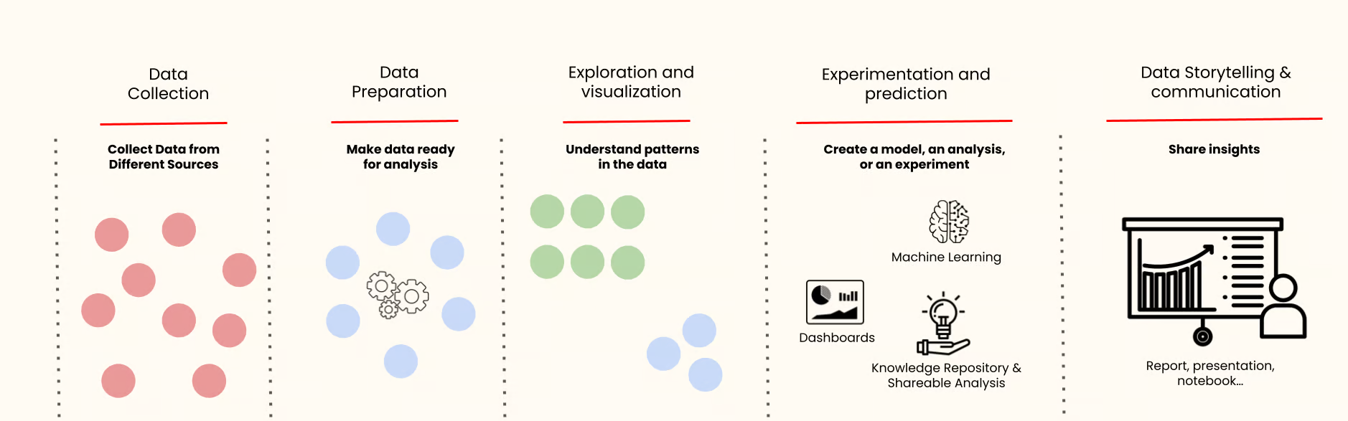
The data science lifecycle
The data science lifecycle refers to the various stages a data science project generally undergoes, from initial conception and data collection to communicating results and insights.

Slide 4
Data collection and storage
This initial phase involves collecting data from various sources, such as databases, Excel files, text files, APIs, web scraping, or even real-time data streams. The type and volume of data collected largely depend on the problem you’re addressing.
Once collected, this data is stored in an appropriate format ready for further processing. Storing the data securely and efficiently is important to allow quick retrieval and processing.
Data preparation
Often considered the most time-consuming phase, data preparation involves cleaning and transforming raw data into a suitable format for analysis. This phase includes handling missing or inconsistent data, removing duplicates, normalization, and data type conversions. The objective is to create a clean, high-quality dataset that can yield accurate and reliable analytical results.
Exploration and visualization
During this phase, data scientists explore the prepared data to understand its patterns, characteristics, and potential anomalies. Techniques like statistical analysis and data visualization summarize the data's main characteristics, often with visual methods.
Visualization tools, such as charts and graphs, make the data more understandable, enabling stakeholders to comprehend the data trends and patterns better.

Slide 5
Experimentation and prediction
Data scientists use machine learning algorithms and statistical models to identify patterns, make predictions, or discover insights in this phase.
The goal here is to derive something significant from the data that aligns with the project's objectives, whether predicting future outcomes, classifying data, or uncovering hidden patterns.
Data Storytelling and communication
The final phase involves interpreting and communicating the results derived from the data analysis. It's not enough to have insights; you must communicate them effectively, using clear, concise language and compelling visuals.
The goal is to convey these findings to non-technical stakeholders in a way that influences decision-making or drives strategic initiatives.

Slide 6
Techniques:
Regression Analysis: A technique for modeling relationships between dependent and independent variables, often used for predicting continuous outcomes (e.g., linear regression, logistic regression).
Classification: The process of predicting discrete labels for new data based on a trained model (e.g., decision trees, random forests, support vector machines).
Clustering: A technique used to group similar data points together without predefined labels (e.g., k-means, hierarchical clustering).
Natural Language Processing (NLP): Techniques for analyzing and understanding human language, enabling tasks such as text classification, sentiment analysis, and machine translation.
Neural Networks: A model inspired by the human brain, used for complex tasks like image recognition, language modeling, and game playing (e.g., deep learning).

Slide 7
Jobs and Career in Data Science
A data science job involves using various techniques, algorithms, and tools to extract insights and knowledge from structured and unstructured data. Here are some of the key data science job roles:
Data Scientist:
  Responsibilities: Analyzing large datasets, developing machine learning models, interpreting results, and providing insights to inform business decisions.
  Skills: Proficiency in programming languages like Python or R, expertise in statistics and machine learning algorithms, data visualization skills, and domain knowledge in the relevant industry.
Data Analyst:
  Responsibilities: Collecting, cleaning, and analyzing data to identify trends, patterns, and insights. Often involves creating reports and dashboards to communicate findings to stakeholders.
  Skills: Strong proficiency in SQL for data querying, experience with data visualization tools like Tableau or Power BI, basic statistical knowledge, and familiarity with Excel or Google Sheets.
Machine Learning Engineer:
  Responsibilities: Building and deploying machine learning models at scale, optimizing model performance, and integrating them into production systems.
  Skills: Proficiency in programming languages like Python or Java, experience with machine learning frameworks like TensorFlow or PyTorch, knowledge of cloud platforms like AWS or Azure, and software engineering skills for developing scalable solutions.

Slide 8
Data Engineer:
  Responsibilities: Designing and building data pipelines to collect, transform, and store large volumes of data. Ensuring data quality, reliability, and scalability.
  Skills: Expertise in database systems like SQL and NoSQL, proficiency in programming languages like Python or Java, experience with big data technologies like Hadoop or Spark, and knowledge of data warehousing concepts.
Business Intelligence (BI) Analyst:
  Responsibilities: Gathering requirements from business stakeholders, designing and developing BI reports and dashboards, and providing data-driven insights to support strategic decision-making.
  Skills: Proficiency in BI tools like Tableau, Power BI, or Looker, strong SQL skills for data querying, understanding of data visualization principles, and ability to translate business needs into technical solutions.
Data Architect:
  Responsibilities: Designing the overall structure of data systems, including databases, data lakes, and data warehouses. Defining data models, schemas, and data governance policies.
  Skills: Deep understanding of database technologies and architectures, experience with data modeling tools like ERWin (Erwin Data Modeler (stylized as erwin but formerly as ERwin) is computer software for data modeling.) or Visio, knowledge of data integration techniques, and familiarity with data security and compliance regulations.

Slide 9
Applications of Data Science:
Data science has broad applications across industries, including:
Healthcare: Diagnosing diseases, predicting patient outcomes, and personalizing treatment plans.
Finance: Risk modelling, fraud detection, and stock market analysis.
Retail: Recommendation systems, customer segmentation, and inventory management.
Marketing: Targeted advertising, campaign analysis, and customer sentiment analysis.
Manufacturing: Predictive maintenance and quality control.
Transportation: Route optimization and demand forecasting.
Sports: Player performance analysis and game strategy optimization.

Slide 10
Benefits of Data Science:
Improved Decision Making:
  Data science allows organizations to make better, data-driven decisions by analyzing large datasets.
  This reduces reliance on intuition and helps provide evidence-based insights.
Automation of Tasks:
  Machine learning algorithms can automate repetitive and time-consuming tasks, leading to higher efficiency and productivity.
  For example, automated data cleaning, classification, and prediction tasks.
Predictive Analytics:
  Data science enables businesses to predict future trends and behaviors.
  For example, predicting customer churn, product demand, or stock market trends.
Cost Efficiency:
  By identifying inefficiencies and bottlenecks through data analysis, organizations can optimize resources and reduce operational costs.
  For example, in finance, it is used for fraud detection and risk assessment.

Slide 11
Personalization:
  Companies like Netflix and Amazon use data science to create personalized recommendations for users, improving user engagement and satisfaction.
Competitive Advantage:
  Organizations that effectively use data science can gain a competitive edge by understanding market trends, consumer preferences, and internal performance better than their competitors.
Enhanced Customer Experience:
  By analyzing customer data, companies can tailor their products, services, and interactions to better meet customer needs, increasing satisfaction and loyalty.
Risk Management:
  Data science helps in identifying potential risks by analyzing historical data and detecting patterns.

Slide 12
Uses of Data Science:
Business and Marketing:
  Customer Segmentation: Analyzing customer data to divide them into distinct segments for targeted marketing.
  Sales Forecasting: Predicting future sales based on historical data, seasonal trends, and external factors.
  Recommendation Systems: Powering personalized product recommendations on platforms like e-commerce sites and streaming services.
Healthcare:
  Medical Imaging: Data science algorithms can help in interpreting medical images, such as detecting tumors or other anomalies in scans.
  Predictive Health Models: Predicting patient outcomes, the likelihood of disease progression, or hospital readmission based on historical medical data.
  Drug Discovery: Using machine learning to analyze molecular data and identify potential candidates for drug development.
Finance and Banking:
  Fraud Detection: Using patterns in financial transactions to identify fraudulent activities.
  Algorithmic Trading: Developing algorithms that can analyze market data and make trading decisions in real-time.
  Credit Scoring: Analyzing credit history and other financial data to determine the creditworthiness of an individual.
Manufacturing and Supply Chain:
  Predictive Maintenance: Predicting when machinery will need maintenance, helping prevent costly breakdowns.
  Supply Chain Optimization: Using data to forecast demand and optimize the flow of goods to minimize inventory costs.

Slide 13
Government and Public Sector:
  Crime Prediction and Prevention: Using data to analyze crime patterns and predict areas at risk for criminal activity.
  Urban Planning: Analyzing traffic data, environmental data, and population data to help in city planning and development.
  Public Health Initiatives: Monitoring disease outbreaks, identifying trends, and designing more effective public health programs.
Sports and Entertainment:
  Player Performance Analysis: Analyzing player statistics to optimize team strategy and performance.
  Fan Engagement: Understanding fan behavior and preferences to create targeted content and increase engagement.
Energy and Environment:
  Energy Consumption Forecasting: Predicting energy demand and optimizing power grid operations.
  Climate Modeling: Using data science to model and predict climate change and environmental impacts.
Education:
  Personalized Learning: Creating data-driven personalized learning plans based on student performance and behavior.
  Educational Policy Analysis: Using data science to analyze the effectiveness of educational programs and policies.

Slide 14
Facets of data
The facets of data refer to the different characteristics, aspects, or dimensions through which data can be examined, understood, and used.
Volume
Definition: Refers to the sheer amount or quantity of data generated. In today's digital world, large volumes of data are produced continuously from various sources like social media, transactions, sensors, and devices.
Example: The vast amount of data collected by social media platforms, IoT sensors, or customer transaction logs.
Velocity
Definition: The speed at which data is generated, collected, and processed. This facet emphasizes real-time data processing or data that flows rapidly and needs to be handled at high speeds.
Example: Streaming data from financial markets, social media feeds, or live sensor data in autonomous vehicles.
Variety
Definition: Refers to the different types or formats of data. Data can be structured (e.g., relational databases), semi-structured (e.g., JSON, XML), or unstructured (e.g., text, images, video).
Example: Data coming from diverse sources, such as structured data in databases, unstructured text in documents, and multimedia data from videos.

Slide 15
Veracity
Definition: Refers to the trustworthiness, accuracy, and reliability of data.
It concerns the quality and authenticity of data, ensuring that the data used for analysis is valid and dependable.
Example: Data that is inaccurate, incomplete, or inconsistent, such as a set of customer records where some fields are missing or corrupted.
Value
Definition: Refers to the usefulness or worth of the data.
Not all data has intrinsic value, and some data requires significant processing or contextual understanding to derive actionable insights.
Example: Customer data might provide valuable insights into purchasing patterns and preferences when analyzed properly.
Variability
Definition: Refers to the inconsistency of data over time or in different contexts.
Variability in data can arise from various factors, such as seasonal changes, human behavior, or evolving trends.
Example: Sales data showing spikes during certain months due to seasonal effects or promotions.

Slide 16
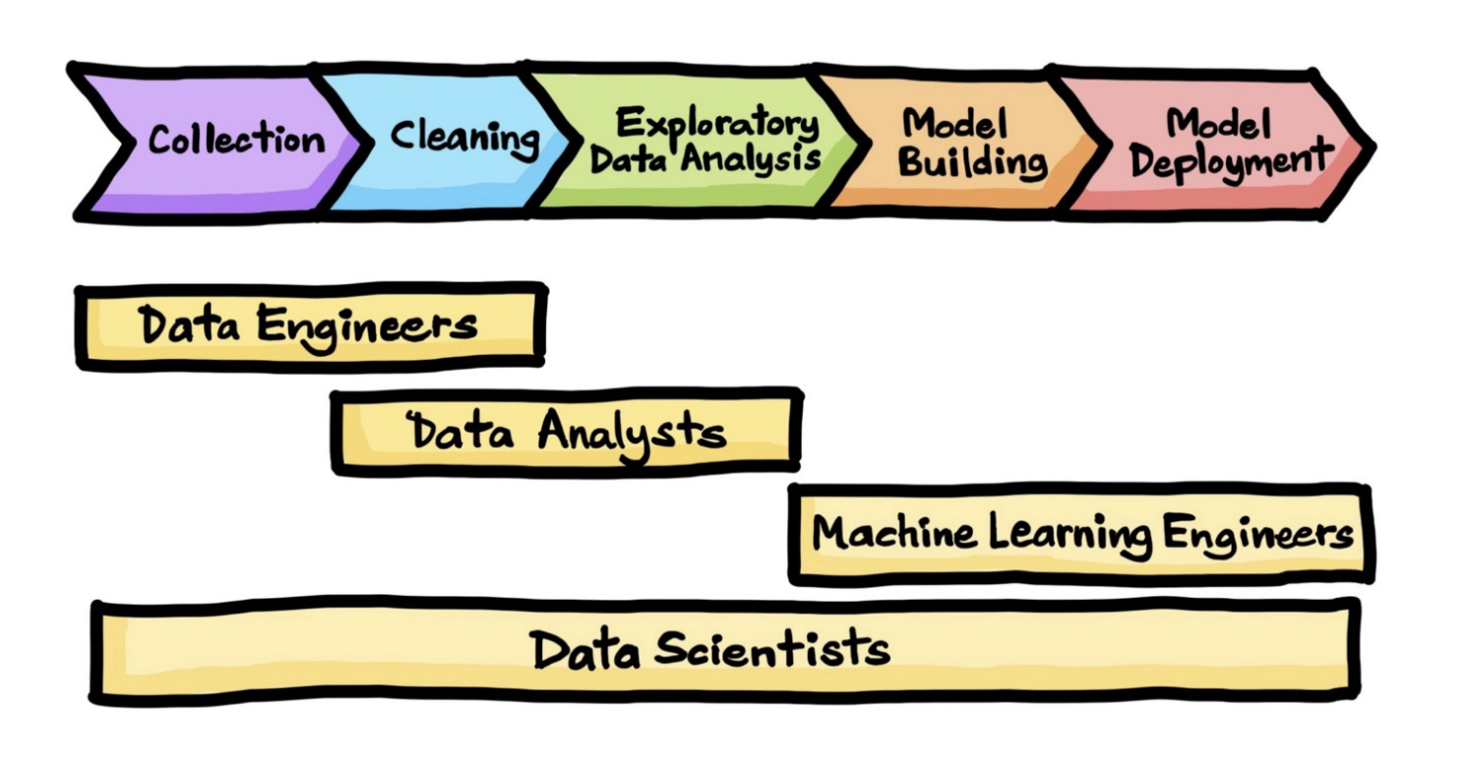
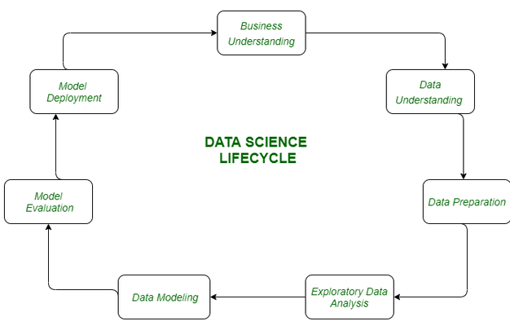
Data Science Process
What Is the Data Science Process?
The data science process is a systematic approach to solving a data problem.
It provides a structured framework for articulating your problem as a question, deciding how to solve it, and then presenting the solution to stakeholders.
Data Engineers : They build and maintain data pipelines.
Data Analysts: They focus on interpreting data and generating reports.
Data Architect : They design data management systems.
Machine Learning Engineer : They develop and deploy predictive models.
Deep Learning Engineer : They create more advanced AI models to process complex data.

Slide 17
Data Science Process Life Cycle
Data Collection
After formulating any problem statement, the main task is to calculate data that can help us in our analysis and manipulation.
Sometimes data is collected by performing some kind of survey and there are times when it is done by performing scrapping.
Data Cleaning
Most of the real-world data is not structured and requires cleaning and conversion into structured data before it can be used for any analysis or modeling.
Exploratory Data Analysis
This is the step in which we try to find the hidden patterns in the data at hand.
Also, we try to analyze different factors which affect the target variable and the extent to which it does so.
How the independent features are related to each other and what can be done to achieve the desired results all these answers can be extracted from this process as well.
This also gives us a direction in which we should work to get started with the modeling process.
Model Building
Different types of machine learning algorithms as well as techniques have been developed which can easily identify complex patterns in the data which will be a very tedious task to be done by a human.
Model Deployment
After a model is developed and gives better results on the holdout or the real-world dataset then we deploy it and monitor its performance.
This is the main part where we use our learning from the data to be applied in real-world applications and use cases.

Slide 18
Key Components of Data Science Process
Data Science is a very vast field and to get the best out of the data at hand one has to apply multiple methodologies and use different tools to make sure the integrity of the data remains intact throughout the process keeping data privacy in mind.
Data Analysis
There are times when there is no need to apply advanced deep learning and complex methods to the data at hand to derive some patterns from it.
Due to this before moving on to the modelling part, we first perform an exploratory data analysis to get a basic idea of the data and patterns which are available in it this gives us a direction to work on if we want to apply some complex analysis methods on our data.
Statistics
It is a natural phenomenon that many real-life datasets follow a normal distribution. And when we already know that a particular dataset follows some known distribution then most of its properties can be analyzed at once.
Also, descriptive statistics and correlation and covariances between two features of the dataset help us get a better understanding of how one factor is related to the other in our dataset.
Data Engineering
When we deal with a large amount of data then we have to make sure that the data is kept safe from any online threats also it is easy to retrieve and make changes in the data as well.
To ensure that the data is used efficiently Data Engineers play a crucial role.

Slide 19
Advanced Computing
Machine Learning
Machine Learning has opened new horizons which had helped us to build different advanced applications and methodologies so, that the machines become more efficient and provide a personalized experience to each individual and perform tasks in a snap of the hand earlier which requires heavy human labor and time intense.
Deep Learning
This is also a part of Artificial Intelligence and Machine Learning but it is a bit more advanced than machine learning itself.
High computing power and a huge corpus of data have led to the emergence of this field in data science.

Slide 20
Knowledge and Skills for Data Science Professionals
Statistics:
Defines it as the study of the collection, analysis, interpretation, presentation, and organization of data.
Programming Language R/ Python:
Python and R are one of the most widely used languages by Data Scientists.
The primary reason is the number of packages available for Numeric and Scientific computing.
Data Extraction, Transformation, and Loading:
Suppose we have multiple data sources like MySQL DB, MongoDB, Google Analytics.
You have to Extract data from such sources, and then transform it for storing in a proper format or structure for the purposes of querying and analysis.
Finally, you have to load the data in the Data Warehouse, where you will analyze the data.

Slide 21
Steps for Data Science Processes:
Step 1: Define the Problem and Create a Project Charter
Clearly defining the research goals is the first step in the Data Science Process.
A project charter outlines the objectives, resources, deliverables, and timeline, ensuring that all stakeholders are aligned.
Step 2: Retrieve Data
Data can be stored in databases, data warehouses, or data lakes within an organization.
Accessing this data often involves navigating company policies and requesting permissions.
Step 3: Data Cleansing, Integration, and Transformation
Data cleaning ensures that errors, inconsistencies, and outliers are removed.
Data integration combines datasets from different sources, while data transformation prepares the data for modelling by reshaping variables or creating new features.
Step 4: Exploratory Data Analysis (EDA)
During EDA, various graphical techniques like scatter plots, histograms, and box plots are used to visualize data and identify trends.
This phase helps in selecting the right modelling techniques.
Step 5: Build Models
In this step, machine learning or deep learning models are built to make predictions or classifications based on the data.
The choice of algorithm depends on the complexity of the problem and the type of data.
Step 6: Present Findings and Deploy Models
Once the analysis is complete, results are presented to stakeholders.
Models are deployed into production systems to automate decision-making or support ongoing analysis.

Slide 22
Tools for Data Science Process
The Data Science Process involves various stages, and each stage requires specific tools.
1. Data Collection & Acquisition
🔹 APIs & Web Scraping: BeautifulSoup, Scrapy, Selenium
🔹 Databases & Querying: MySQL, PostgreSQL, MongoDB
🔹 Big Data Processing: Hadoop, Apache Spark
2. Data Cleaning & Preparation
🔹 Data Manipulation: Pandas, NumPy
🔹 ETL (Extract, Transform, Load): Talend, Apache NiFi
🔹 Data Wrangling: OpenRefine, Trifacta
3. Data Exploration & Visualization
🔹 Statistical Analysis: R, MATLAB, SciPy
🔹 Data Visualization: Matplotlib, Seaborn, Tableau, Power BI
4. Model Building & Machine Learning
🔹 ML Libraries: Scikit-learn, TensorFlow, PyTorch, XGBoost
🔹 AutoML Tools: H2O.ai, Google AutoML
🔹 Deep Learning: Keras, OpenCV
5. Model Deployment & Monitoring
🔹 Deployment Frameworks: Flask, FastAPI, Docker
🔹 Model Serving: TensorFlow Serving, MLflow, AWS SageMaker
🔹 CI/CD for ML: Kubeflow, MLflow
6. Big Data & Cloud Computing
🔹 Cloud Platforms: AWS, Google Cloud, Microsoft Azure
🔹 Big Data Frameworks: Apache Spark, Dask

Slide 23
Challenges in the Data Science Process
The Data Science Process involves multiple stages, each presenting unique challenges.
1. Data Collection & Acquisition Challenges
🔹Data Availability: Finding relevant and high-quality data is difficult.
🔹Data Silos: Data may be spread across different departments, making integration difficult.
🔹Unstructured Data: A large portion of data (text, images, videos) is unstructured and requires special handling.
2. Data Cleaning & Preparation Challenges
🔹Missing or Inconsistent Data: Handling missing values, duplicate data, and inconsistencies.
🔹Data Transformation Complexity: Converting raw data into a structured format suitable for analysis.
🔹Handling Outliers: Identifying and dealing with anomalies without losing valuable information.
3. Data Exploration & Feature Engineering Challenges
🔹High Dimensionality: Too many features can lead to overfitting and increased computational costs.
🔹Feature Selection: Identifying the most relevant features to improve model performance.
🔹Bias in Data: Imbalanced datasets can lead to biased predictions and poor generalization.
4. Model Building & Machine Learning Challenges
🔹Algorithm Selection: Choosing the right machine learning model for the problem.
🔹Hyperparameter Tuning: Optimizing model parameters to achieve the best performance.
🔹Computational Cost: Some models, like deep learning, require extensive computational power.
🔹Overfitting & Underfitting: Balancing model complexity to generalize well on new data.

Slide 24
5. Model Deployment & Maintenance Challenges
🔹Scalability: Ensuring the model can handle real-world data and increasing workloads.
🔹Real-time Processing: Deploying models that can make real-time predictions with low latency.
🔹Model Drift: Models degrade over time as data distributions change, requiring continuous monitoring.
🔹Version Control: Keeping track of different model versions and updates.
6. Ethical & Interpretability Challenges
🔹Model Explainability: Many AI models (especially deep learning) act as "black boxes" and are difficult to interpret.
🔹User Trust & Adoption: Convincing stakeholders to trust and adopt data-driven insights.
7. Big Data & Cloud Infrastructure Challenges
🔹Storage & Processing Costs: Managing large-scale data storage and computational expenses.
🔹Data Security: Protecting data from breaches and unauthorized access.
🔹Integration with Existing Systems: Deploying models within an organization's infrastructure.

Slide 25
Data Mining
The process of extracting information to identify patterns, trends, and useful data that would allow the business to take the data-driven decision from huge sets of data is called Data Mining.
Data mining is one of the most useful techniques that help entrepreneurs, researchers, and individuals to extract valuable information from huge sets of data.
Data mining is also called Knowledge Discovery in Database (KDD).
The knowledge discovery process includes Data cleaning, Data integration, Data selection, Data transformation, Data mining, Pattern evaluation, and Knowledge presentation.
Data mining is the act of automatically searching for large stores of information to find trends and patterns that go beyond simple analysis procedures.
Data mining utilizes complex mathematical algorithms for data segments and evaluates the probability of future events.
Data Mining is similar to Data Science carried out by a person, in a specific situation, on a particular data set, with an objective.
This process includes various types of services such as text mining, web mining, audio and video mining, pictorial data mining, and social media mining.

Slide 26
Types of Data Mining
Relational Database:
A relational database is a collection of multiple data sets formally organized by tables, records, and columns from which data can be accessed in various ways without having to recognize the database tables.
Tables convey and share information, which facilitates data searchability, reporting, and organization.
Data warehouses:
A Data Warehouse is the technology that collects the data from various sources within the organization to provide meaningful business insights.
The huge amount of data comes from multiple places such as Marketing and Finance.
The extracted data is utilized for analytical purposes and helps in decision- making for a business organization.
The data warehouse is designed for the analysis of data rather than transaction processing.
Data Repositories:
The Data Repository generally refers to a destination for data storage.
However, many IT professionals utilize the term more clearly to refer to a specific kind of setup within an IT structure.
For example, a group of databases, where an organization has kept various kinds of information.

Slide 27
Object-Relational Database:
A combination of an object-oriented database model and relational database model is called an object-relational model.
It supports Classes, Objects, Inheritance, etc.
One of the primary objectives of the Object-relational data model is to close the gap between the Relational database and the object-oriented model practices frequently utilized in many programming languages, for example, C++, Java, C#, and so on.
Transactional Database:
A transactional database refers to a database management system (DBMS) that has the potential to undo a database transaction if it is not performed appropriately.
Even though this was a unique capability a very long while back, today, most of the relational database systems support transactional database activities.

Slide 28
Advantages of Data Mining
The Data Mining technique enables organizations to obtain knowledge-based data.
Data mining enables organizations to make productive modifications in operation and production.
Compared with other statistical data applications, data mining is a cost-efficient.
Data Mining helps the decision-making process of an organization.
It Facilitates the automated discovery of hidden patterns as well as the prediction of trends and behaviors.
It can be induced in the new system as well as the existing platforms.
It is a quick process that makes it easy for new users to analyze enormous amounts of data in a short time.
Disadvantages of Data Mining
Many data mining analytics software is difficult to operate and needs advance training to work on.
Different data mining instruments operate in distinct ways due to the different algorithms used in their design. Therefore, the selection of the right data mining tools is a very challenging task.
The data mining techniques are not precise, so that it may lead to severe consequences in certain conditions.

Slide 29
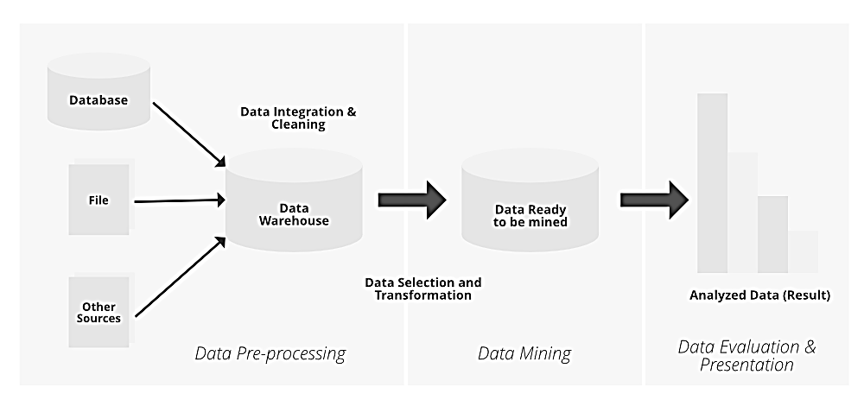
Knowledge Discovery From Data Consists of the Following Steps:
Knowledge discovery from data (KDD) is a multi-step process that involves extracting useful knowledge from data.
Data Selection:
The first step in the KDD process is to select the relevant data for analysis.
This involves identifying the data sources and selecting the data that is necessary for the analysis.
Data Preprocessing:
The data obtained from different sources may be in different formats and may have errors and inconsistencies.
The data preprocessing step involves cleaning and transforming the data to make it suitable for analysis.
Data Transformation:
Once the data has been cleaned, it may need to be transformed to make it more meaningful for analysis.
This involves converting the data into a form that is suitable for data mining algorithms.

Slide 30
Data Mining:
The data mining step involves applying various data mining techniques to identify patterns and relationships in the data.
This involves selecting the appropriate algorithms and models that are suitable for the data and the problem being addressed.
Pattern Evaluation:
After the data mining step, the patterns and relationships identified in the data need to be evaluated to determine their usefulness.
This involves examining the patterns to determine whether they are meaningful and can be used to make predictions or decisions.
Knowledge Representation:
The patterns and relationships identified in the data need to be represented in a form that is understandable and useful to the end-user.
This involves presenting the results in a way that is meaningful and can be used to make decisions.
Knowledge Refinement:
The knowledge obtained from the data mining process may need to be refined further to improve its usefulness.
This involves using feedback from the end-users to improve the accuracy and usefulness of the results.
Knowledge Dissemination:
The final step in the KDD process involves disseminating the knowledge obtained from the analysis to the end-users.
This involves presenting the results in a way that is easy to understand and can be used to make decisions.

Slide 31
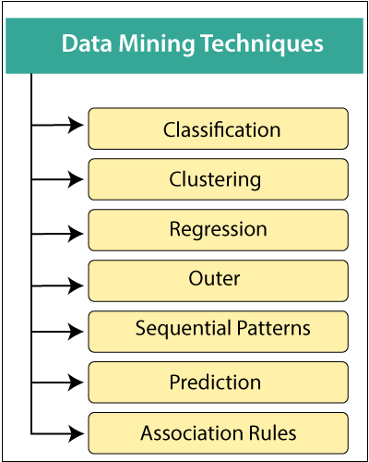
Data Mining Techniques
Data mining includes the utilization of refined data analysis tools to find previously unknown, valid patterns and relationships in huge data sets.
These tools can incorporate statistical models, machine learning techniques, and mathematical algorithms, such as neural networks or decision trees.
Thus, data mining incorporates analysis and prediction.
Classification:
This technique is used to categorize data into predefined classes. It uses algorithms such as decision trees, neural networks, and support vector machines.
Classification is often used in applications like email filtering (spam or not spam), bank loan approval (approve or not approve), and medical diagnosis (disease or no disease).
Regression:
Regression analysis is used to identify and analyze the relationship between variables.
It is often used for prediction and forecasting, where the focus is on the relationship between a dependent variable and one or more independent variables.
Linear regression and logistic regression are two common methods.

Slide 32
Clustering:
Clustering involves grouping a set of objects in such a way that objects in the same group (called a cluster) are more similar to each other than to those in other groups.
It is a main task of exploratory data mining, and a common technique for statistical data analysis. K-means, hierarchical clustering, and DBSCAN are popular clustering algorithms.
Association Rule Learning:
This technique is used to discover interesting relations between variables in large databases.
It is intended to identify strong rules discovered in databases using different measures of interestingness.
Apriori and Eclat are algorithms used for association rule learning, often applied in market basket analysis.
Anomaly Detection (Outlier/Change/Deviation Detection):
The objective of anomaly detection is to identify unusual data points, which differ significantly from the majority of the data.
This technique is widely used in fraud detection, system health monitoring, and intrusion detection.
Sequential Pattern Mining:
This technique is used to identify regular sequences of events or patterns over time.
It is useful in applications like customer shopping behavior analysis, web clickstream analysis, and biological sequence analysis.
Prediction:
Prediction used a combination of other data mining techniques such as trends, clustering, classification, etc.
It analyzes past events or instances in the right sequence to predict a future event.

Slide 33
Applications of Data Mining
Data mining has a wide range of applications across various industries, including:
Marketing: Identifying customer segments and targeting marketing campaigns.
Finance: Detecting fraud and assessing risk.
Healthcare: Identifying risk factors for diseases and developing personalized treatment plans.
Retail: Analyzing customer behavior and optimizing product placement².

Slide 34
Data Warehousing
A data warehouse is a centralized system used for storing and managing large volumes of data from various sources.
It is designed to help businesses analyze historical data and make informed decisions.
Data from different operational systems is collected, cleaned, and stored in a structured way, enabling efficient querying and reporting.
  Goal is to produce statistical results that may help in decision-making.
  Ensures fast data retrieval even with the vast datasets.
  Need for Data Warehousing
  Handling Large Volumes of Data: Traditional databases can only store a limited amount of data (MBs to GBs), whereas a data warehouse is designed to handle much larger datasets (TBs), allowing businesses to store and manage massive amounts of historical data.
  Enhanced Analytics: Transactional databases are not optimized for analytical purposes. A data warehouse is built specifically for data analysis, enabling businesses to perform complex queries and gain insights from historical data.
  Centralized Data Storage: A data warehouse acts as a central repository for all organizational data, helping businesses to integrate data from multiple sources and have a unified view of their operations for better decision-making.
  Trend Analysis: By storing historical data, a data warehouse allows businesses to analyze trends over time, enabling them to make strategic decisions based on past performance and predict future outcomes.
  Support for Business Intelligence: Data warehouses support business intelligence tools and reporting systems, providing decision-makers with easy access to critical information, which enhances operational efficiency and supports data-driven strategies.

Slide 35
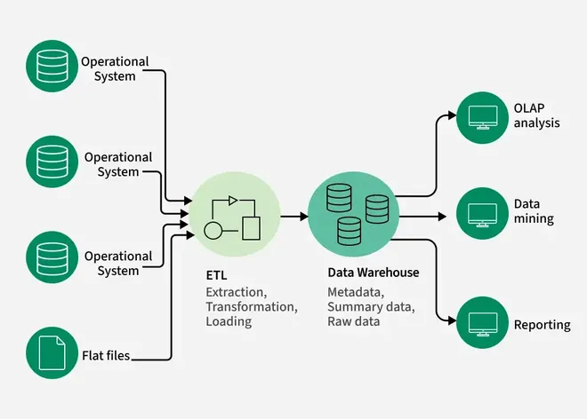
Components of Data Warehouse
Data Sources: These are the various operational systems, databases, and external data feeds that provide raw data to be stored in the warehouse.
ETL (Extract, Transform, Load) Process: The ETL process is responsible for extracting data from different sources, transforming it into a suitable format, and loading it into the data warehouse.
Data Warehouse Database: This is the central repository where cleaned and transformed data is stored. It is typically organized in a multidimensional format for efficient querying and reporting.
Metadata: Metadata describes the structure, source, and usage of data within the warehouse, making it easier for users and systems to understand and work with the data.
Data Marts: These are smaller, more focused data repositories derived from the data warehouse, designed to meet the needs of specific business departments or functions.
OLAP (Online Analytical Processing) Tools: OLAP tools allow users to analyze data in multiple dimensions, providing deeper insights and supporting complex analytical queries.
End-User Access Tools: These are reporting and analysis tools, such as dashboards or Business Intelligence (BI) tools, that enable business users to query the data warehouse and generate reports.

Slide 36
Types of Data Warehouses
Enterprise Data Warehouse (EDW): A centralized warehouse that stores data from across the organization for analysis and reporting.
Operational Data Store (ODS): Stores real-time operational data used for day-to-day operations, not for deep analytics.
Data Mart: A subset of a data warehouse, focusing on a specific business area or department.
Cloud Data Warehouse: A data warehouse hosted in the cloud, offering scalability and flexibility.
Big Data Warehouse: Designed to store vast amounts of unstructured and structured data for big data analysis.
Virtual Data Warehouse: Provides access to data from multiple sources without physically storing it.
Hybrid Data Warehouse: Combines on-premises and cloud-based storage to offer flexibility.
Real-time Data Warehouse: Designed to handle real-time data streaming and analysis for immediate insights.

Slide 37
Benefits of Data Warehousing
Improved Decision-Making:
By providing a consolidated view of data, data warehouses enable better and faster decision-making.
Historical Intelligence:
Data warehouses store historical data, allowing organizations to analyze trends and make informed predictions.
Data Consistency:
Data from various sources is integrated and transformed into a consistent format, ensuring accuracy and reliability.
Enhanced Performance:
Data warehouses are optimized for read-heavy operations, providing fast query performance and reducing the load on transactional systems.
Scalability:
Data warehouses can handle large volumes of data and can be scaled to meet the growing needs of an organization.
Popular Data Warehousing Solutions
Amazon Redshift: A fully managed data warehouse service provided by AWS.
Google BigQuery: A serverless, highly scalable, and cost-effective multi-cloud data warehouse.
Snowflake: A cloud-based data warehousing solution known for its performance and scalability.
Microsoft Azure Synapse Analytics: An analytics service that brings together big data and data warehousing.
Oracle Exadata: A high-performance database machine optimized for running Oracle databases.

Slide 38
Data Warehouse vs DBMS
Database | Data Warehouse
A common Database is based on operational or transactional processing. Each operation is an indivisible transaction. | A data Warehouse is based on analytical processing.
Generally, a Database stores current and up-to-date data which is used for daily operations. | A Data Warehouse maintains historical data over time. Historical data is the data kept over years and can used for trend analysis, make future predictions and decision support.
A database is generally application specific. Example – A database stores related data, such as the student details in a school. | A Data Warehouse is integrated generally at the organization level, by combining data from different databases. Example – A data warehouse integrates the data from one or more databases , so that analysis can be done to get results , such as the best performing school in a city.
Constructing a Database is not so expensive. | Constructing a Data Warehouse can be expensive.

Slide 39
Basic Statistical descriptions of Data.
Statistics
Statistics is the branch of mathematics that deals with collecting, analyzing, interpreting, presenting, and organizing data.
It involves the study of methods for gathering, summarizing, and interpreting data to make informed decisions and draw meaningful conclusions.
Statistics is widely used in various fields such as science, economics, social sciences, business, and engineering to provide insights, make predictions, and guide decision-making processes.
Types of Statistics
There are commonly two types of statistics
Descriptive Statistics:
De­scriptive Statistics helps us simplify and organize big chunks of data.
This makes large amounts of data easier to understand.
Inferential Statistics:
Inferential Statistics is a little different. It uses smaller data to conclude a larger group.
It helps us predict and draw conclusions about a population.

Slide 40
What is Data in Statistics
In statistics, data refers to the collection of facts, numbers, measurements, or observations used for analysis.
Data is the foundation of statistical study and helps in making informed decisions based on trends, patterns, and relationships.
Types of Data in Statistics
Data can be categorized in various ways:
1. Based on Nature of Data
a) Qualitative (Categorical) Data
Definition: Descriptive data that cannot be measured in numerical terms but can be categorized.
Types:
  Nominal Data: Categories with no specific order (e.g., gender, colors, types of fruits).
  Ordinal Data: Categories with a meaningful order but without a fixed difference (e.g., ranking in a competition: 1st, 2nd, 3rd).
b) Quantitative (Numerical) Data
Definition: Data that consists of numerical values and can be measured.
Types:
  Discrete Data: Countable values (e.g., number of students in a class, number of cars in a parking lot).
  Continuous Data: Measured values that can take any value within a range (e.g., height, weight, temperature).

Slide 41
2. Based on Data Collection
a) Primary Data
Collected directly by the researcher for a specific purpose.
Example: A survey conducted to analyze customer preferences.
b) Secondary Data
Collected from existing sources such as research papers, government reports, and databases.
Example: Census data, company financial reports.
3. Based on Measurement Scales (Stevens' Scale)
  Nominal Scale: Labels or names without order (e.g., types of music genres).
  Ordinal Scale: Ordered data but without fixed differences (e.g., education levels: primary, secondary, higher).
  Interval Scale: Ordered data with equal intervals but no true zero (e.g., temperature in Celsius).
  Ratio Scale: Ordered data with a true zero and equal intervals (e.g., weight, height, income).
Data Important in Statistics?
  Supports Decision-Making – Used in business, medicine, and science to make data-driven decisions.
  Identifies Patterns & Trends – Helps in forecasting future trends based on historical data.
  Validates Hypotheses – Used in research to test theories and assumptions.
  Improves Accuracy – Reduces uncertainty in decision-making.

Slide 42
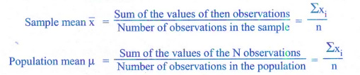
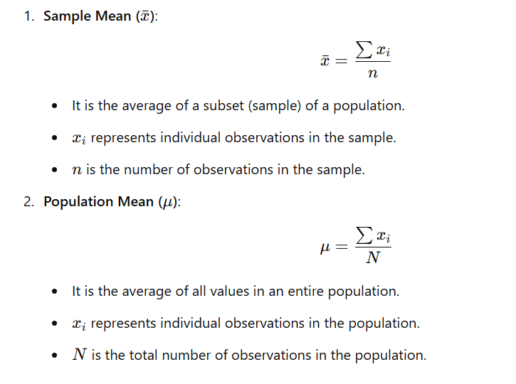
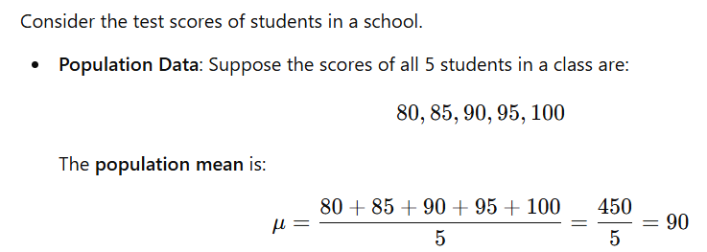
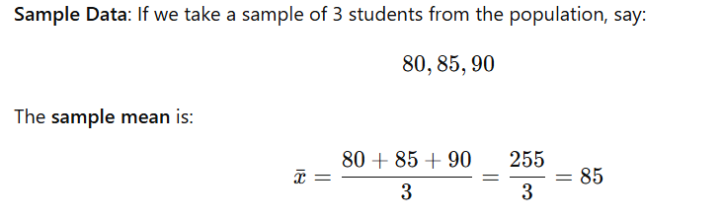
Basic Statistical Descriptions of Data
Measuring the Central Tendency
We look at various ways to measure the central tendency of data, include: Mean, Weighted mean, Trimmed mean, Median, Mode and Midrange.
Mean :
The mean of a data set is the average of all the data values.
The sample mean x is the point estimator of the population mean μ.

Slide 43
Median:
The median of a data set is the value in the middle when the data items are arranged in ascending order.
Whenever a data set has extreme values, the median is the preferred measure of central location.
Example
For an off number of observations:
7 observations= 26, 18, 27, 12, 14, 29, 19.
Numbers in ascending order = 12, 14, 18, 19, 26, 27, 29
The median is the middle value.
Median=19
For an even number of observations :
8 observations = 26 18 29 12 14 27 30 19
Numbers in ascending order =12, 14, 18, 19, 26, 27, 29, 30
The median is the average of the middle two values.
Median = 19, 26

Slide 44
Mode
The mode is the value that appears most frequently in a data set.
Types of Mode:
  Unimodal: A data set with one mode (one most frequent value).
  Bimodal: A data set with two modes (two values that appear most frequently).
  Multimodal: A data set with three or more modes.
  No Mode: If all values occur with the same frequency, the data set has no mode.
No Mode
Example
Consider the numbers:
10,20,30,40,50
Each number appears only once, so there is no mode.
Unimodal Data Set
Consider the numbers: 2,3,4,4,5,6,7
The number 4 appears twice, while all others appear once.
So, the mode = 4.
Bimodal Data Set
Consider the numbers: 1,2,2,3,4,4,5
The numbers 2 and 4 both appear twice, more than other numbers.
So, the modes = 2 and 4 (Bimodal).
Multimodal Data Set
Example:
Consider the numbers: 1,2,2,3,3,4,4,5,6
The numbers 2, 3, and 4 each appear twice, while others appear only once.
Since there are three modes, this is a multimodal data set.
Modes = 2, 3, and 4

Slide 45
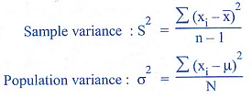

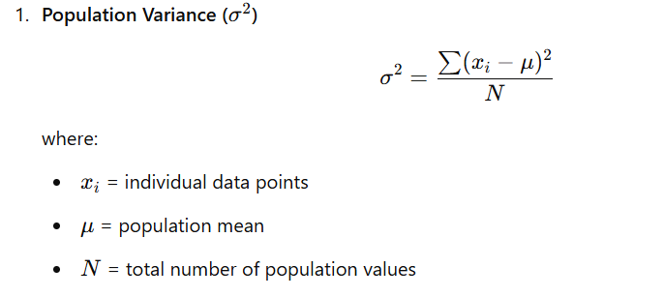
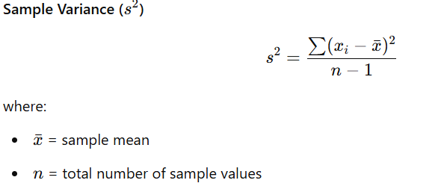
Measuring the Dispersion of Data: Dispersion refers to the spread of data points around a central value (mean, median, or mode). It helps us understand how much the data varies.
Range – Difference between the maximum and minimum values.
Range=Max−Min
Example: If the test scores are 45, 50, 60, 70, 80,
Range = 80 - 45 = 35.
Variance (σ² or s²):
The variance is a measure of variability that utilizes all the data.
It is based on the difference between the value of each observation (x) and the mean ( ) for a sample, μ for a population).
The variance is the average of the squared between each data value and the mean.

Slide 46
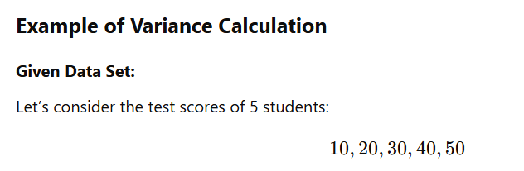
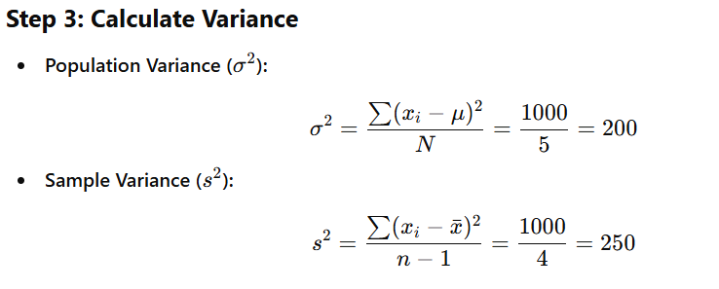
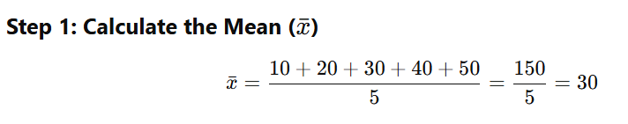
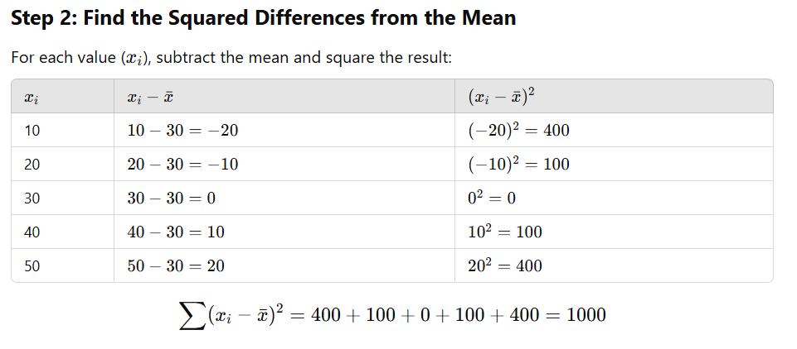
Final Answer:
  Population Variance = 200
  Sample Variance = 250

Slide 47
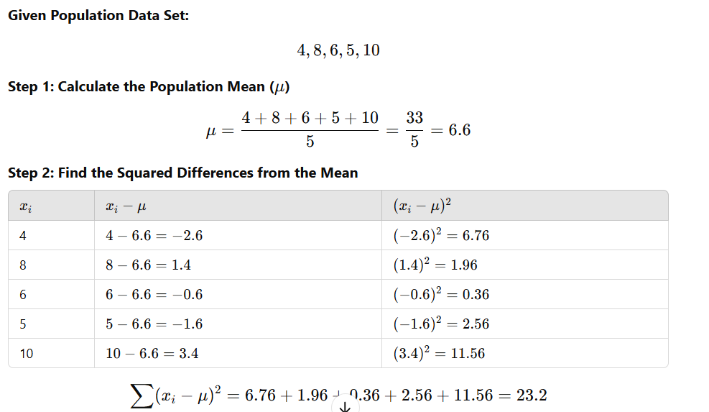
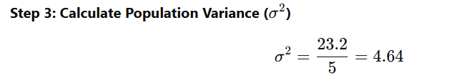

Slide 48
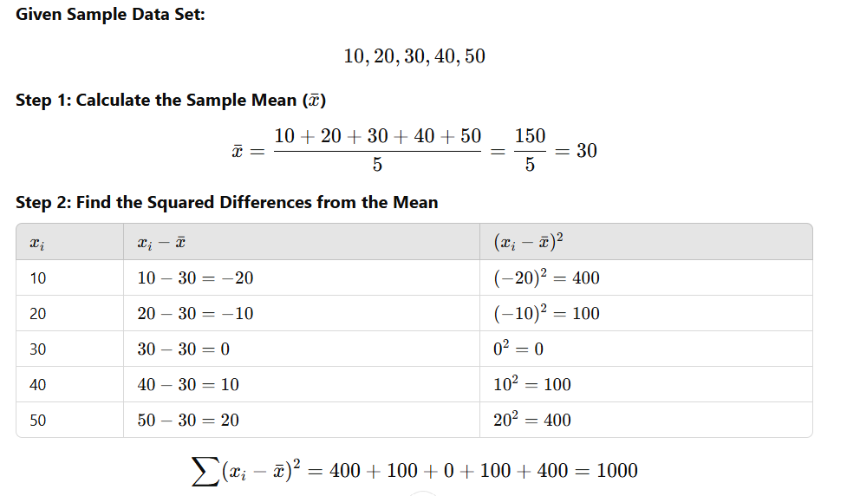
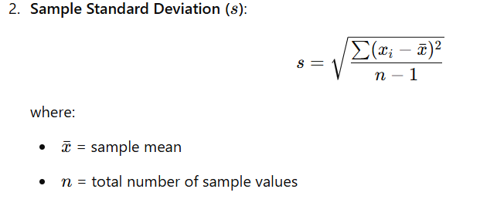
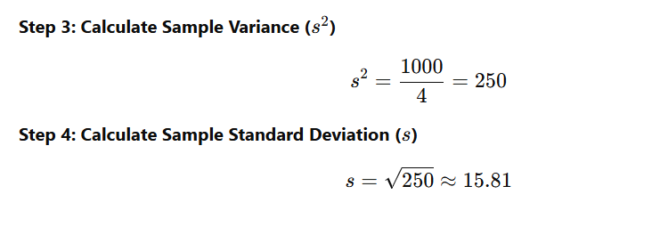
Deviation
Sample Standard Deviation (s)
The sample standard deviation (s) measures how much the values in a sample deviate from the mean. It is the square root of the sample variance (s²).
`

Slide 49
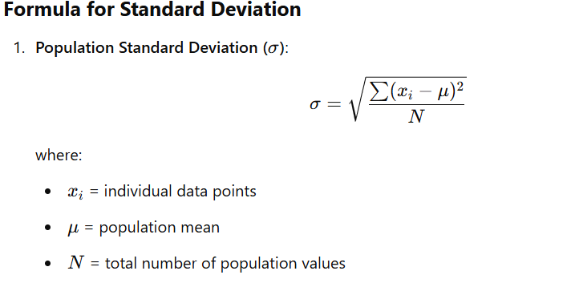
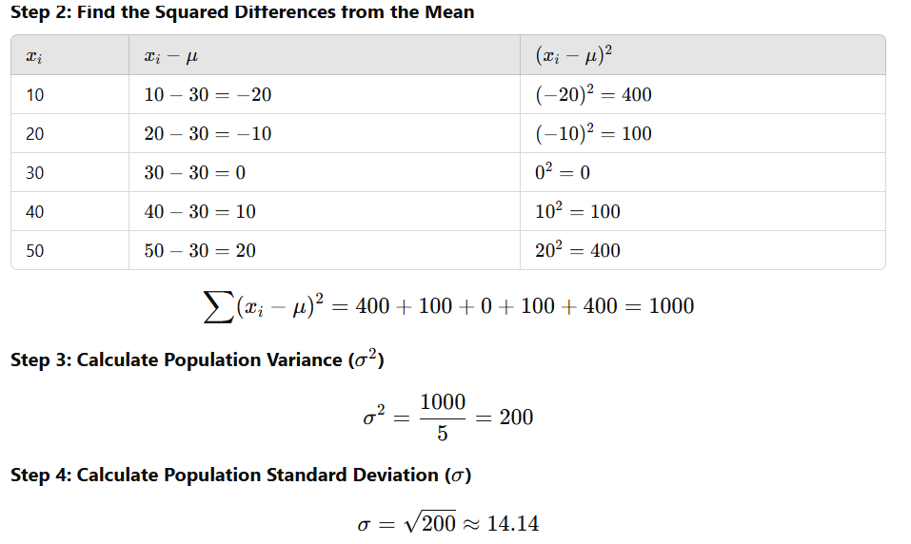
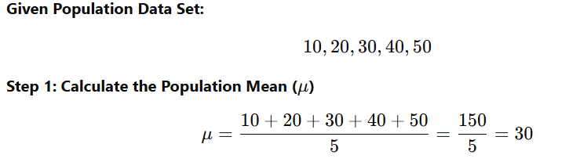
Population Standard Deviation (σ) Calculation
The population standard deviation (σ) measures how much each data point in a population deviates from the population mean (μ).
It is the square root of the population variance (σ²).

Slide 50
Interquartile Range (IQR)
The Interquartile Range (IQR) is a measure of statistical dispersion, representing the range within which the middle 50% of a dataset falls.
An outlier is an observation that lies an abnormal distance from other values in a random sample from a population.
First quartile (Q1): The first quartile is the value, where 25% of the values are smaller than Q1 and 75% are larger.
Third quartile (Q3): The third quartile is the value, where 75 % of the values are smaller than Q3 and 25% are larger.
The box plot is a useful graphical display for describing the behaviour of the data in the middle as well as at the ends of the distributions.
The box plot uses the median and the lower and upper quartiles.
If the lower quartile is Q1 and the upper quartile is Q3, then the difference (Q3 - Q1) is called the interquartile range or IQ.
Formula for IQR
IQR=Q3−Q1
where:
Q1 (First Quartile) = Median of the lower half of data (25th percentile)
Q3 (Third Quartile) = Median of the upper half of data (75th percentile)

Slide 51
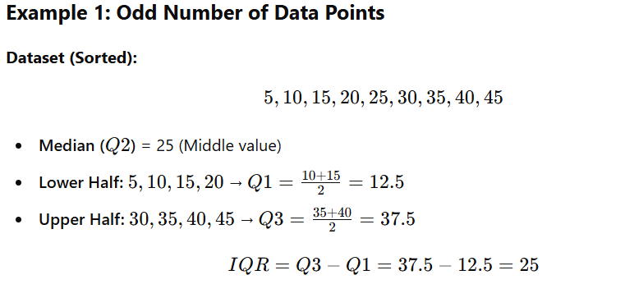
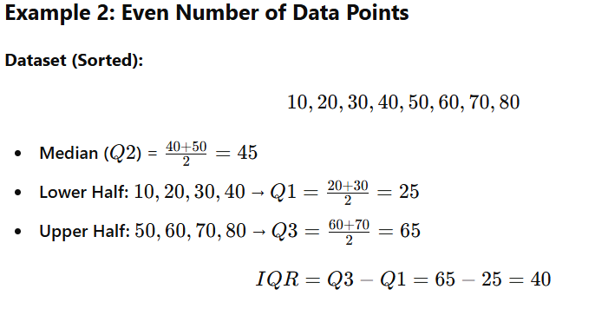

Slide 52
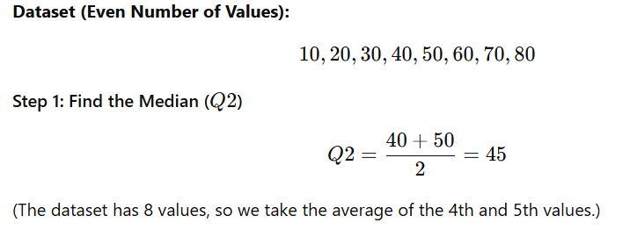
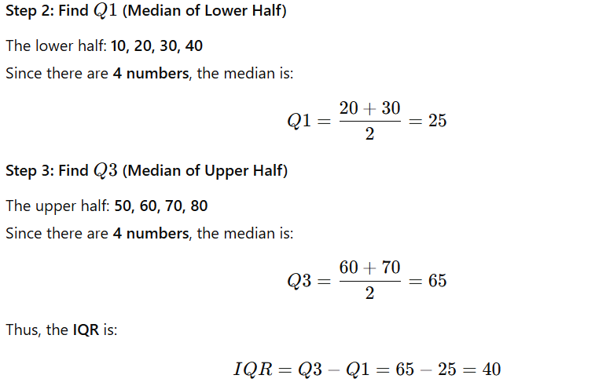

Slide 53
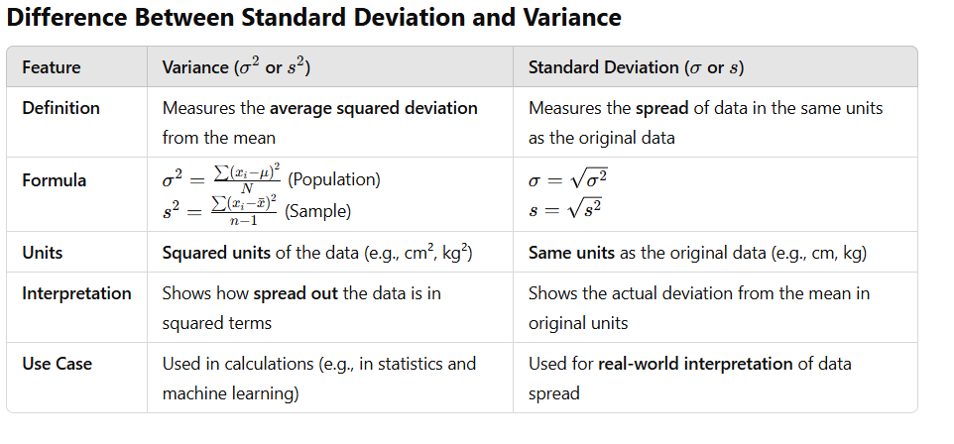

Slide 54
Graphic Displays of Basic Statistical Descriptions
Graphs in statistics serve as powerful tools for visually representing data, making it easier to interpret, compare, and analyze trends.
These graphical representations help in identifying patterns, relationships, and distributions within datasets.
There are many types of graphs for the display of data summaries and distributions, such as Bar charts, Pie charts, Line graphs, Boxplot, Histograms, Quantile plots and Scatter plots.
The Types Of Graphs
The most commonly used types of graphs in statistics include:
  Statistical Graphs (e.g., bar graph, pie chart, line graph, etc.)
  Exponential Graphs
  Logarithmic Graphs
  Trigonometric Graphs
  Frequency Distribution Graphs

Slide 55
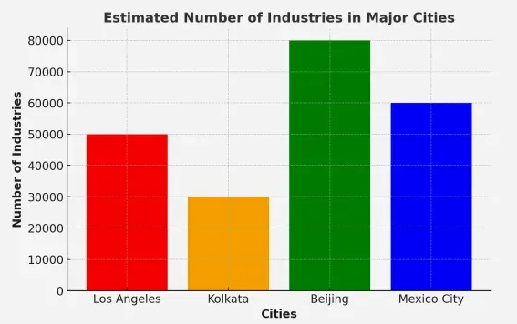
Statistical Graphs
A statistical graph or chart is a pictorial representation of statistical data in a graphical format.
These graphs help in understanding data trends, patterns, and distributions effectively.
Types of Statistical Graphs
  Bar Graph
  Line Graph
  Pie Chart
  Histogram
  Bar Graph:
  A bar graph is a visual representation of grouped data using rectangular bars.
  The length of each bar is proportional to the value it represents.
  The horizontal axis represents categorical data, while the vertical axis represents numerical data.
  Bar graphs are commonly used for comparing different categories within a dataset.

Slide 56
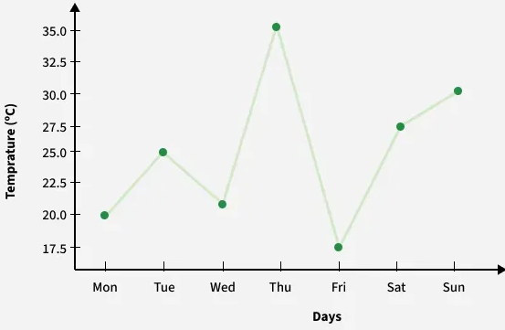
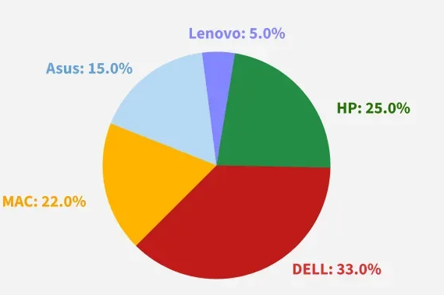
Line Graph
A line graph is a chart that uses points connected by lines to show changes over time. It is useful for tracking trends and comparing data over continuous intervals.
The horizontal axis represents the independent variable (e.g., time), while the vertical axis represents the dependent variable (e.g., sales or temperature).
All data value is represented in points and later they connected by line from one to other i.e. in “dot-to-dot” fashion.
Pie Chart
A pie chart is a circular graph divided into sectors, where each sector represents a proportion of the whole dataset.
Pie charts are useful for showing percentage distributions and comparing relative sizes of categories within a dataset.

Slide 57
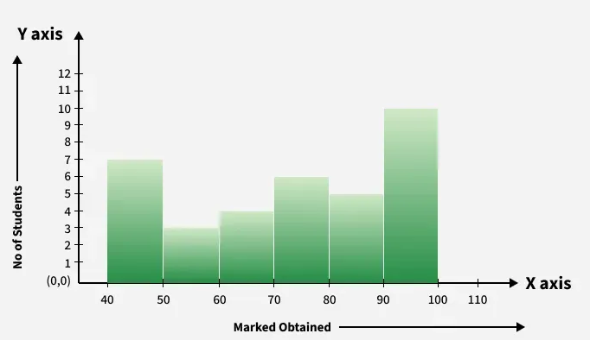
Histogram
A histogram is a type of bar graph that represents the frequency of numerical data within specific intervals.
Unlike a standard bar graph, the bars in a histogram are adjacent, representing continuous data distribution.
Marks obtained | 40-50 | 50-60 | 60-70 | 70-80 | 80-90 | 90-100
Number of Students | 7 | 3 | 4 | 6 | 5 | 10

Slide 58
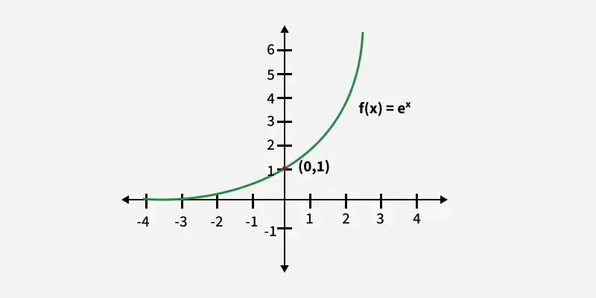
Exponential Graphs
Exponential graphs are used to represent exponential functions.
Exponential functions are of the form f(x) = ka^{x}
where,
  x is Independent Variable
  k is Some Constant
  a is Base of Exponential Graph
These graphs can be either increasing or decreasing, depending on the nature of the function.
For example, the graph of y = 3^{x} is an increasing exponential graph, while the graph of y = 3^{(-x)} is a decreasing exponential graph.

Slide 59
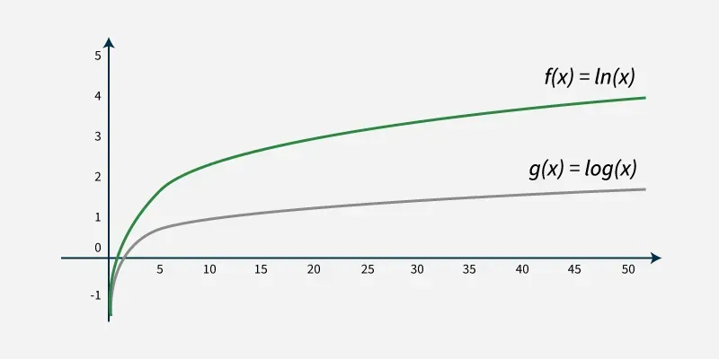
Logarithmic Graphs
Logarithmic graphs are the inverse of exponential graphs.
They are plotted similarly using a table of values and reflect a slow increase as the input variable grows.
For example, the inverse of y = 3^{x} is y = log₃(x), which represents a logarithmic graph.

Slide 60
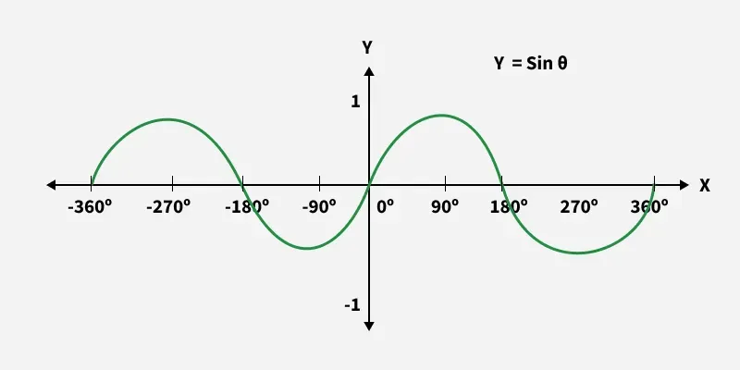
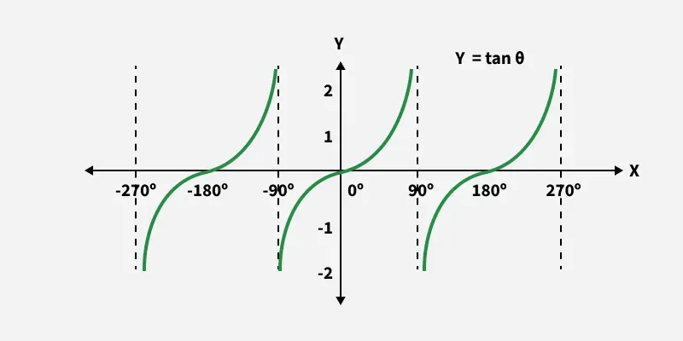
Trigonometric Graphs
Trigonometric graphs represent the functions of sine, cosine, tangent, cotangent, secant, and cosecant.
These graphs are periodic, meaning they repeat their values at regular intervals, making them essential for understanding cyclic patterns.
The shape and behavior of each graph depend on the amplitude, frequency, and phase shift of the trigonometric function.
This is the trigonometric graph of sine:
This is the trigonometric graph of tangent:

Slide 61
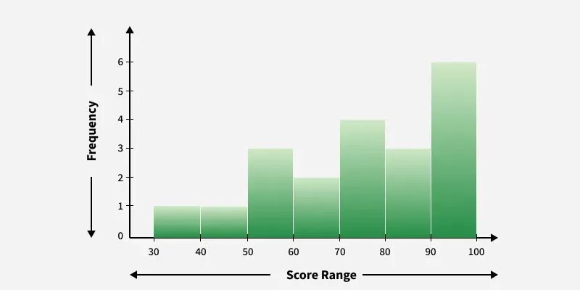
Frequency Distribution Graphs
A frequency distribution graph shows the number of occurrences of different outcomes in a dataset.
Typically, frequency distributions are represented using bar graphs or histograms.
This type of graph is commonly used in statistical analysis to understand data spread and frequency patterns.
A frequency distribution illustrates how often each value of a variable occurs within a dataset.
It organizes data into categories or intervals, displaying the number of occurrences for each, making it easier to analyze patterns and trends.

